Slide 1
Communication Styles
NAZIA KOONJ
LECTURER, MUET

Slide 2
Communication Styles
Analytical
Assertive/Aggressive
Creative
Decisive
Flexible

Slide 3
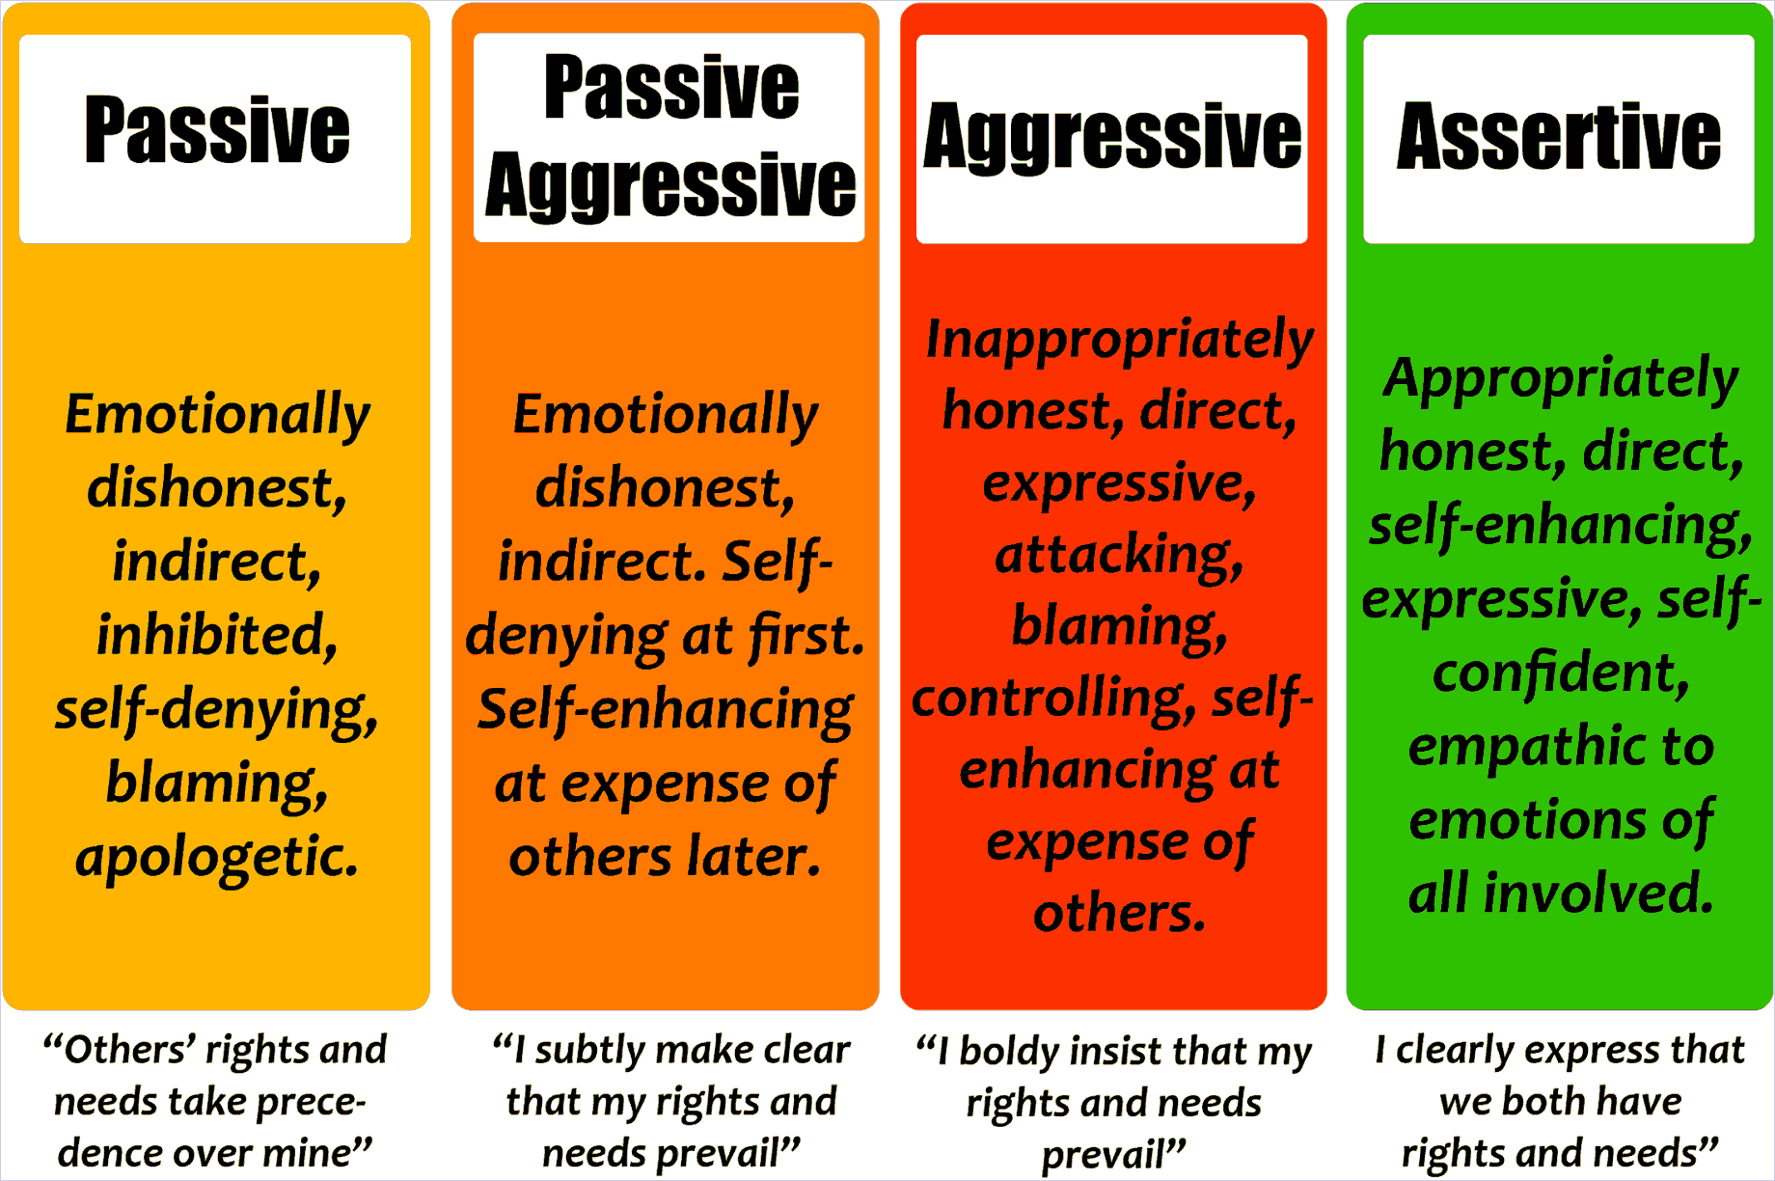

Slide 4
Analytical Communication
Process oriented; prefers to communicate about:
Facts and figures
Policies and procedures
Systems and Organizations
Planning and forecasting
Analysis and control

Slide 5
Analytical communication
Those that communicate with an analytical style prefer to work from data and facts and use them to support what they say. Analytical communicators are often common in upper-management types. While it may seem less personal, analytical communication is a great way to make solid arguments for initiatives that you believe in. Analytical communicators use very precise and rehearsed language to make their points.

Slide 6


Slide 7
Core Concepts
The analytical communication style can be a very effective one in business settings. A few core concepts of the analytical style for communicating in, or with people who use the style:
Use numbers to back up your points. While other styles might want a more top-down view of the company’s status, analytical communicators prefer hard facts and numbers to display the point.
Use logic instead of emotions. Analytical communicators will always prefer to use logic instead of emotions to make their points. Major business decisions with this group must always include hard facts that help to demonstrate their point of view.
A lack of small-talk. Analytical communicators aren’t generally the best conversationalists on the personal level. Limit small talk to communicate effectively with analytical-style communicators.
The analytical communication style is a popular and effective one in business settings but can be seen as a bit impersonal to those that communicate using other styles.

Slide 8
Aggressive/Assertive Communication
There are many factors that play a role in leading groups to solutions (which can also be defined as achieving success), but how a leader communicates with his or her group is an especially pertinent one.
Two common communication styles are “aggressive” and “assertive.” Although they may appear similar at first glance, the differences in both the approach and the results of these two styles are dramatic. Here is a closer look at these two styles and how practicing assertiveness enables one’s leadership to become more natural, positive, and effective.

Slide 9
[n
Aggressive | Assertive
Denies the rights of others | Does not use inappropriate anger or emotion
Insults | Does not try to hurt others Is honest, fair, and direct
Wins at all costs | Allows others to save face
Is emotionally charged | Expresses emotion using eye contact and positive body language
Lacks consideration and empathy for others Damages others’ self-esteem | Practices good listening behaviors

Slide 10
Outcomes of Aggressive Communication
Makes others feel disrespected
Triggers aggression in others
Builds walls
Escalates situations
Leads to negative interactions

Slide 11
Outcomes of Assertive Communication
Makes others feel valued and respected
Builds team players
Opens the door to collaborative solutions
Minimizes stressful situations
Improves relationships

Slide 12
Creative Communication
Creative communication is communicating creatively in a way that best connects with your target audience, and can help bring clarity to your marketing through either visual aid and/ or other forms of visual interaction with the viewer.
It involves communication through
Video content
Bookend meetings
Digital notice boards
Teaser campaigns

Slide 13
Decisive communication
Someone who prefers directive communication is decisive, and likes to take matters into their own hands. Through the internal social network, this person will regularly post to remind people of the tasks that need to be done, and ask them about their status,.
This style is decisive, competitive, independent, and confident. Because the person with a Direct communication style is focused, results-oriented, ambitious, goal-oriented, and driven, others may perceive her as strong-willed or demanding.

Slide 14
Flexible Communication Style
communication flexibility appears to be a central aspect of communication competence. People who are flexible should be more competent— effective and appropriate—in communication situations. They should be able to adapt to the demands of the situation and adjust.
Being flexible in your style of communication is key if you really want them to 'get it.' Doing so can increase your close rates, improve your marriage, and diminish frustration when dealing with employees.

Slide 15
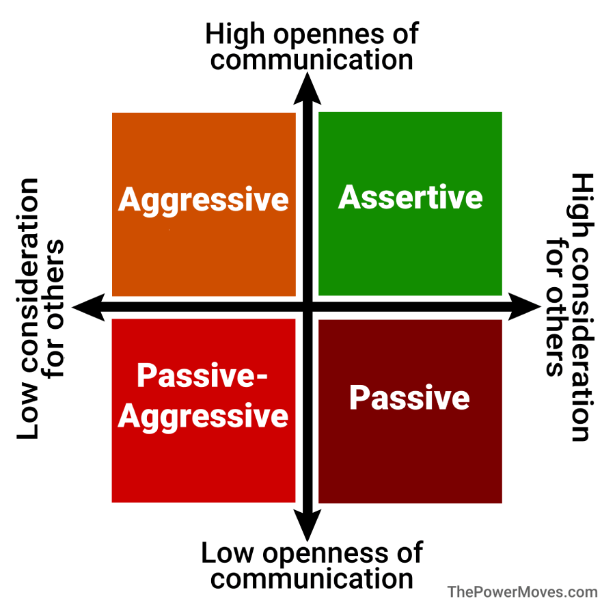

Slide 16
The very first step is to listen and watch.
If you are speaking with a prospect for the very first time, encourage them to do much of the talking so you can assess their personality style and communicate accordingly.
A corporate executive, for instance, may be very directive. A director wants to cut to the chase and will use their words economically.
Approaching this personality-type in a touchy-feely, creative mode will drive a wedge between you faster than you can pass a hot potato!
In order to communicate effectively with this person you must get directly to the point, be concise, never make excuses, and align the outcome with their goals. All in about 5 minutes!

Slide 17
If you are meeting with someone who seems very chatty and wants to discuss their life, including the outcome of their son's soccer game, you are in the presence of a socializer. This person wants you to be excited about things with and for them. Getting down to business without a social flair will create mistrust and send him packing.
Read the cues and follow suit; it's no different than speaking to your baby in baby talk or taking a translation book with you to a foreign country. It's just another form of communication; not a personality transplant, nor is it manipulative. You are respecting your listener's style by adapting to it and speaking their language. You will like the results and so will they.

Slide 18
Importance of flexibility in communication
Flexibility and an open mind. Being flexible gives you the power to influence people around you. Being flexible is a communication skill and tool, and it means to think and behave accordingly to the situation.

Slide 19
PRACTICE
List down the situations and communicating styles you have when you are in different contexts.
For examples.
Teacher
Peers/Fellows
At home being daughter/son/brother/sister
At the mall while shopping
What behaviors/communication styles you chose for yourself according to situation?

Slide 20
3 Steps to Identify Communication Styles
When meeting someone for the first time, there are three things to do:
Ask Questions
Observe Reactions
Listen Actively
My goal is to size someone up within five minutes. Ask a question like: “What do you do to stay current with trends in your business?” Or: “What kind of person is successful in your field?”

Slide 21
References
https://cmoe.com/blog/aggressive-vs-assertive-communication-for-leaders/
https://www.tandfonline.com/doi/abs/10.1080/10417949409372934?journalCode=rsjc20
https://www.business2community.com/communications/identify-communication-styles-01316564

